Slide 1

Zoning Article G
MBTA Communities Multifamily Housing
_____________________________
Planning Board Public Hearing
January 29, 2024

Slide 2
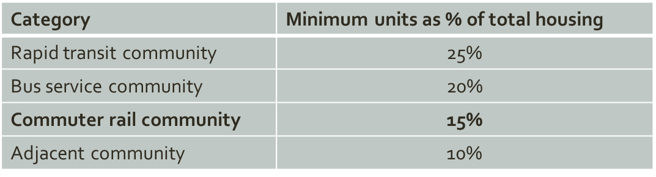
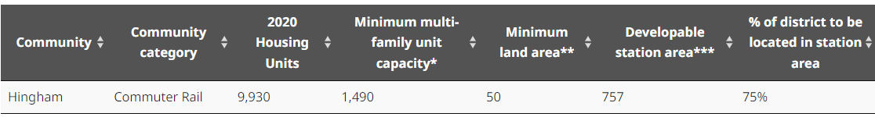
MBTA Communities Multifamily Housing
Intent: Create regulations that would allow multifamily development by-right within in a new overlay district (consisting of approximately 50 acres of land), as required by Section 3A of the Zoning Act.
3A Guidelines Require Zoning Capacity, Not Production

Slide 3
What Does the State Law Require of Hingham?
Hingham must create a Zoning District of at least 50 acres that allows:
  Multifamily housing (cannot be age-restricted, but 10-20% may be affordable)
  Has a total unit capacity of 1,490 units
    What does “capacity” mean? It means that if all of the land in the district were to be developed or redeveloped, a total of up to 1,490 units could be developed there, subject to local wetland and septic regulations
75%-100% of the District must be within 0.5 miles of a transit station. The station can be located in Hingham or in an adjacent town.
  Up to 25% (12.5 acres) can be outside of the 0.5 mile radius of any station
  There can be one large district or the district can be made of subdistricts. Taken together the total district must satisfy minimum acres and minimum unit capacity.
  State law does not allow many types of properties to count toward district acreage:
    Land owned by state or town, conservation or park land, institutional land (e.g. private schools)
Notes:
1-person - $82,950
2-person - $94,800
3-person - $106,650
4-person - $118,450

Slide 4
MBTA Communities – Impact of Noncompliance
Statute: Housing Choice, MassWorks, HousingWorks, and Local Capital Projects Fund (Housing Authority)
Discretionary:
Community Planning Grants
Massachusetts Downtown Initiative
Urban Agenda
Rural & Small Town Development Fund
Brownfields Redevelopment Fund
Site Readiness Program
Underutilized Properties Program
Collaborative Workspace Program
Real Estate Services Technical Assistance
Commonwealth Places Programs
Land Use Planning Grants
Local Acquisitions for Natural Diversity (LAND) Grants, and
Municipal Vulnerability Preparedness (MVP)
Determinations of compliance also may inform other funding decisions by EOED, EOHLC, the MBTA and other state agencies which consider local housing policies when evaluating applications for discretionary grant programs or making other discretionary funding decisions.
Attorney General Advisory on Civil Enforcement Action
Notes:
State grant programs will take compliance with Section 3A into consideration when making grant award recommendations:
These grant programs impact Hingham’s ability to get state funds for current planned and future projects. For example, Weir River Water System will be applying for MassWorks grants for water system improvements.

Slide 5
MBTA Communities
Timeline
May 2, 2022
Hold Briefing with Select Board Submit MBTA Community Information Form to DHCD to maintain interim compliance Submit updated parcel data to MassGIS
August 10, 2022
DHCD issues Final Compliance Guidelines (Modified October 21, 2022)
November 22, 2022
DHCD releases Compliance Model and Guidance Materials
January 31, 2023
Analyze current zoning for compliance with Final Guidelines Develop Action Plan for zoning amendments and submit to DHCD to maintain interim compliance
December 31, 2024
Initiate zoning amendments (December 1, 2023 Submission Deadline) Hold public hearing/s (January – March 2024) Town Meeting action (April 2024) Submit District Compliance Application to DHCD
Notes:
5 Public Meeting with the Select Board and Planning Board
3 Public Meeting PB review draft zoning during the fall
Staff discussion with representatives of Democratic Town Committee, World Affairs Group at the Senior Center and affected property owners
MHP 3A/TA technical services grant – Bohler Engineering completed draft compliance model
One Stop Housing Choice Grant to complete EFA related to inclusionary zoning – Quotes received over the past week; consultant selection will be made early this week
More outreach in coming weeks
Submission of draft zoning to EOHLC for informal review

Slide 6
MBTA Communities
Local Process
2022-2023: 5 Public Meetings with the Select Board and Planning Board
Fall 2023: 3 Public Meetings – Planning Board reviewed draft zoning during the fall
Staff discussions with representatives of the Democratic Town Committee, World Affairs Group at the Senior Center and owners of parcels that may be rezoned
MHP 3A/TA technical services grant – Bohler Engineering completed draft compliance model
Housing Choice Grant – RKG engaged to complete Economic Feasibility Analysis to increase inclusional zoning
More public sessions in coming weeks
Submission of draft zoning to EOHLC for informal review
Notes:
5 Public Meeting with the Select Board and Planning Board
3 Public Meeting PB review draft zoning during the fall
Staff discussion with representatives of Democratic Town Committee, World Affairs Group at the Senior Center and affected property owners
MHP 3A/TA technical services grant – Bohler Engineering completed draft compliance model
One Stop Housing Choice Grant to complete EFA related to inclusionary zoning – Quotes received over the past week; consultant selection will be made early this week
More outreach in coming weeks
Submission of draft zoning to EOHLC for informal review

Slide 7
MBTA Communities District Options

Slide 8
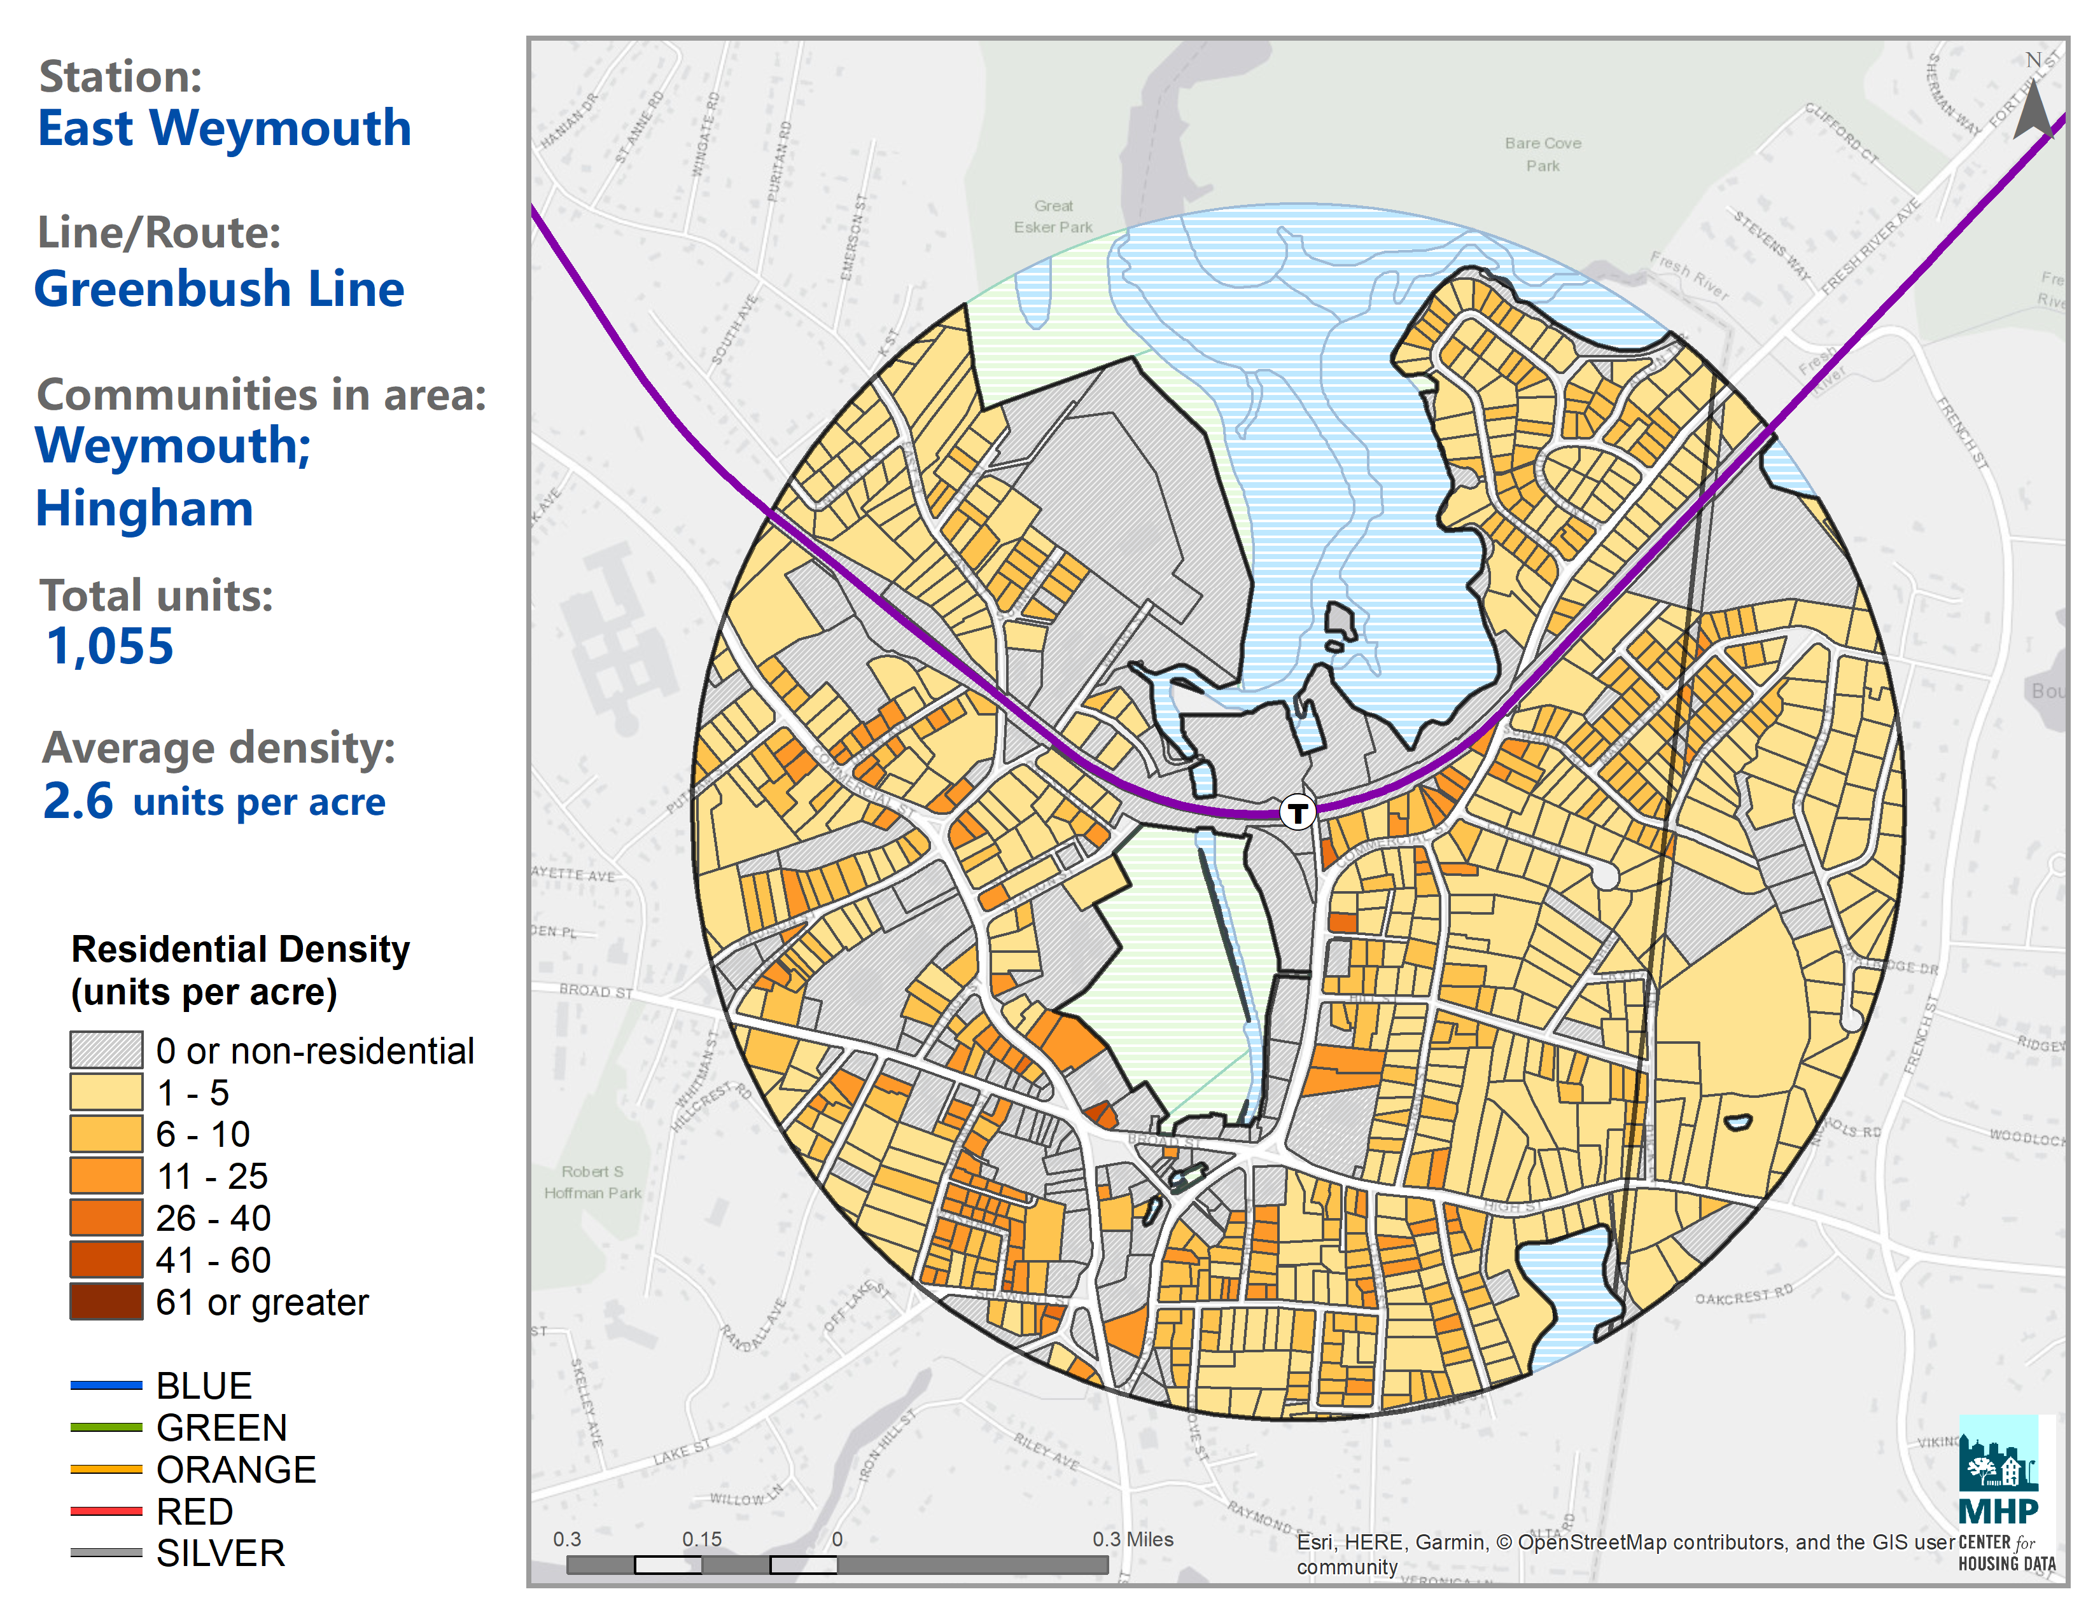
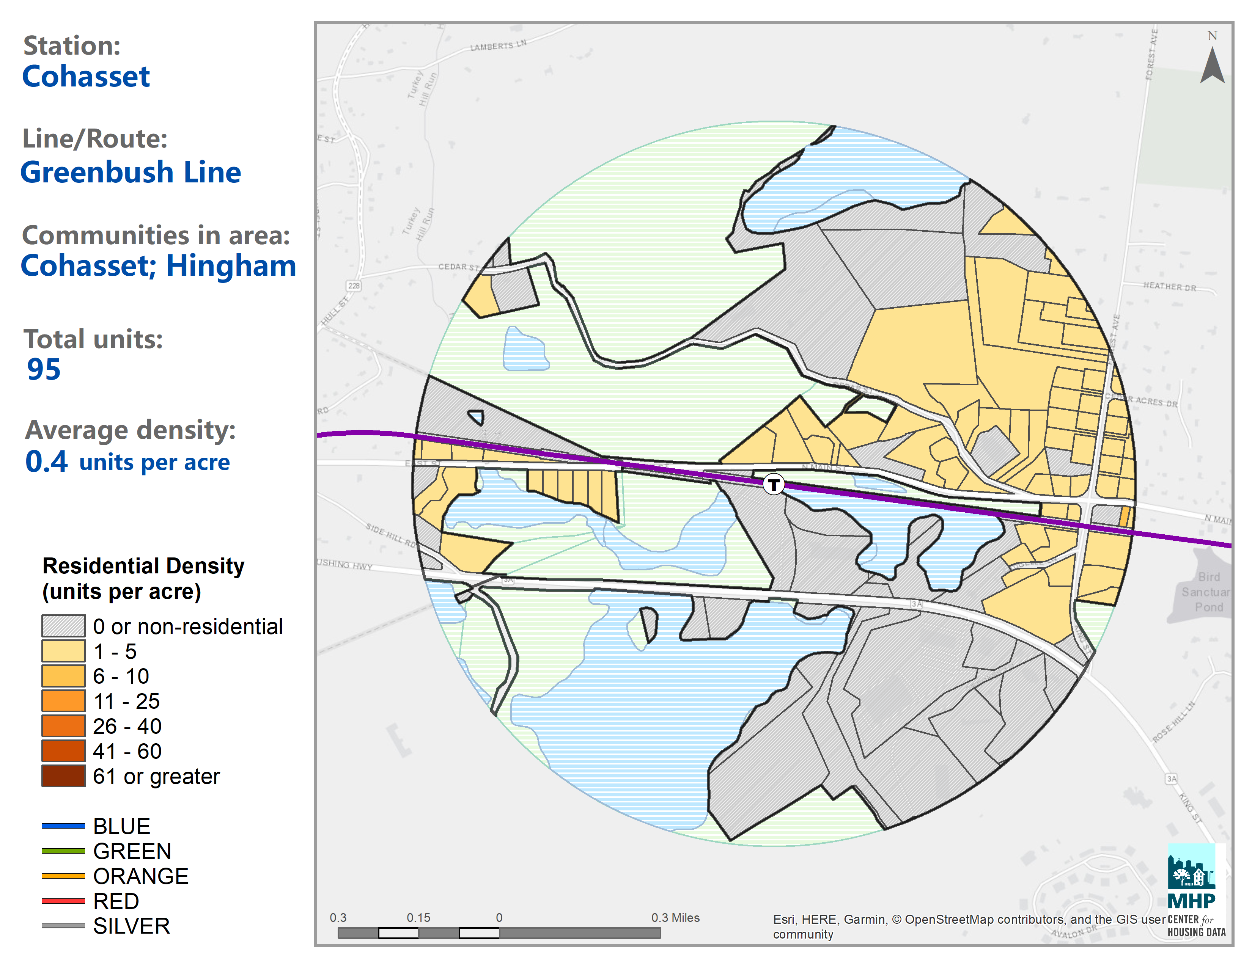
MBTA Communities
District Proposed
Subdistricts

Slide 9
MBTA Communities
District
Proposed Subdistricts
Notes:
Approximately 8 acres

Slide 10
Why Were These Subdistricts Chosen?
Parcels at the Hingham Shipyard:
These parcels have already been permitted for multi-family housing.
Out of the station areas available in Hingham, only the radius around the MBTA Ferry Terminal at the Shipyard provides sufficient acreage that qualifies as “developable land” under the state law to satisfy the majority of Hingham’s minimum size district and minimum unit capacity
French Street Parcels:
Currently zoned residential
Has a historic, nonconforming construction yard (industrial use) that is not compatible to the surrounding area
A MBTA Communities project would be subject to all local regulations and the residential may be less intrusive on the adjoining streets and homes then the current heavy truck traffic, and would be more environmentally friendly
Abuts large areas of open space
Other than the current owner’s home next door, the nearest single-family house would be more than 400’ from the project.
Still within a reasonable distance (2-3 minute drive) from two transit stations

Slide 11
Dimensional Standards
Site Plan Approval requires compliance with all
dimensional, design, and performance standards.
Minimum Lot Size |  | Maximum Height |  | Floor Area Ratio | Maximum Density | Minimum Yard Dimensions
Area | Frontage | Feet | Stories |  | Units/Acre | Front | Side | Rear
Sub-district 1 (Avalon II and Hewitts Landing)
3 acres | 150’ | 45’ | 4 | 0.95 | 40 | 40’ | 25’ | 25’
Sub-district 2 (Avalon Multifamily)
2.5 acres | 200’ | 35’ | 3 | 0.85 | 25 | 20’ | 20’ | 20’
Sub-district 3 (The Cove and French Street Contractors Yard)
5 acres | 200’ | 35’ | 2.5 | 0.85 | 18 | 50’ | 50’ | 50’
Sub-district 4 (Avalon Townhomes )
2 acres | 200’ | 35’ | 2.5 | 0.85 | 15 | 20’ | 20’ | 20’

Slide 12
Permitting Process for MBTA Communities
Zoning
Unlike Chapter 40B Project (such as Riverstone),
MBTA Community Zoning Projects must comply with ALL local land use regulations.
LOCAL REGULATION | 40B PROJECT | MBTA COMMUNITY HOUSING PROJECTS
Hingham Zoning By-Law Dimensional requirements, including lot size, setbacks Full Site Plan Review | May override all applicable local zoning. Site Plan Review by the Planning Board is not permitted. ZBA has burden to show why any local rule should be complied with. | Must comply with Hingham Zoning By-Law, including full site plan review by the Planning Board.
Hingham Wetlands By-Law and Wetland Regulations | May override all local wetland regulations. No local review by the Conservation Commission. ZBA has burden to show why any local regs should be complied with. | Must comply with all Hingham local wetland regulations. Full review by the Conservation Commission.
Hingham Board of Health Regulations (including septic systems) | May override all local septic regulations. No local review by the BOH. ZBA has burden to show why any local regs should be complied with. | Must comply with all Hingham local septic system and other applicable Board of Health regulations. Full review by the Board of Health.

Slide 13
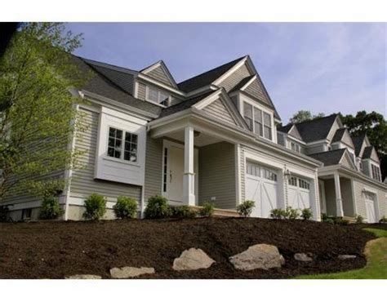
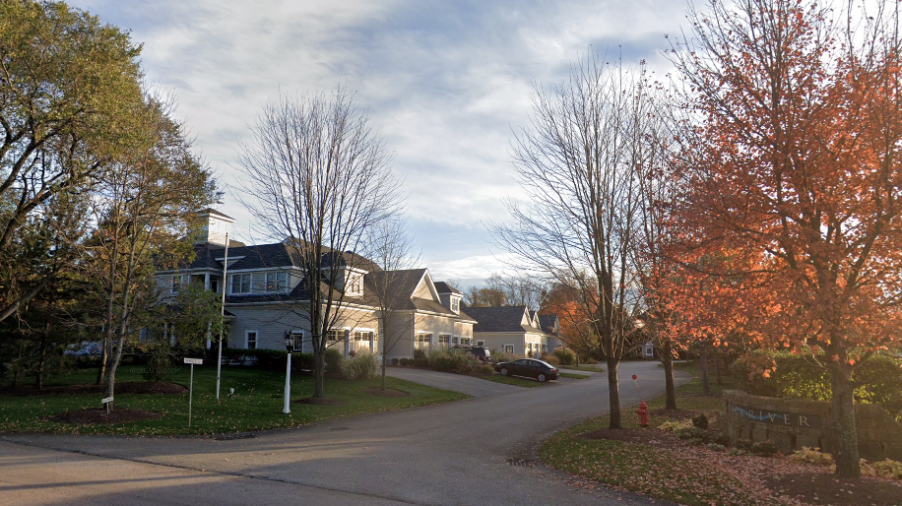
MBTA Community Zoning Projects in Hingham would be upscale market rate housing and would require only 10% - 15% affordability. Many beautiful projects in Hingham have affordable units.
Eligibility for affordable units ranges
from $82,950 to $118,450, depending number of bedrooms and typical household size.
Adams Court | 25% affordable
Avalon Residences | 25% affordable
Back River | 10% affordable
Derby Brook | 25% affordable
Damon Farm | 25% affordable
Whiting Lane | 25% affordable
Notes:
Avalon – 25% affordable (2BR market rate rents avg. $3,000/mo)
Derby Brook – 25% affordable (market rate units est. $1.2m)
Back River – 10% affordable (market rate units est. $1.4m)

Slide 14
Questions and Discussion
________________________________
Thank you for your participation!

